Slide 1

Wine Data
Final Project

Slide 2

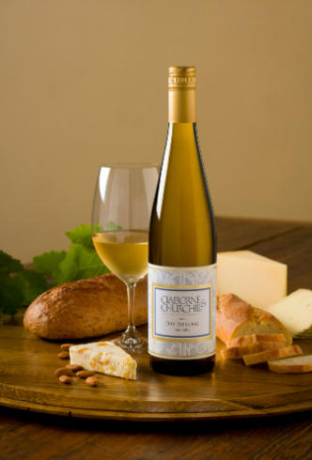
Our Team
Kesley Richards
Nigan Martin
Patrycja Pekala
Yanqiu (Doris) Yang
Jessica Ferraro

Slide 3
Rationale

Slide 4

The data

Slide 5

Potential Further Projects

